Slide 1
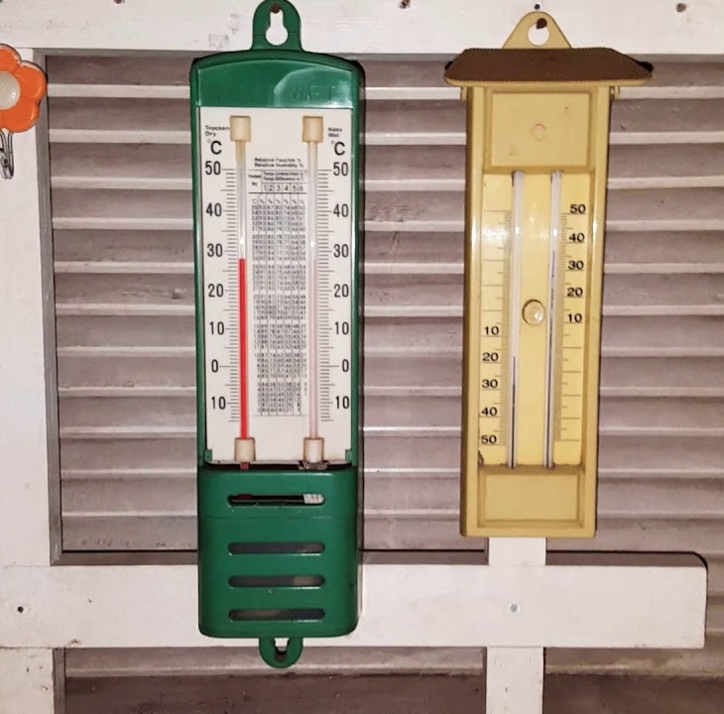
GIS AND TEMPERATURE TREND ANALYSIS: A Case Study of Egyptian Governorates (1984-2024)
By : g7

Slide 2
contents
1- INTRODUCTION
THE OBJECTIVE OF THIS CHAPTER
THE IMPORTANCE OF STUDYING TEMPERATURE CHANGES
2- GIS ROLE IN ANALYZING TEMPERATURE CHANGES
3- DATA COLLECTION
COLLECTING DATA ON METEOROLOGICAL STATION LOCATIONS
COLLECTING TEMPERATURE DATA
4-METHODOLOGY
DISTRIBUTION OF TEMPERATURES OVER DIFFERENT DECADES
TIME SERIES ANALYSIS (TREND ANALYSIS)

Slide 3



THE OBJECTIVE OF THIS CHAPTER
The study focuses on analyzing changes in a key climate element—temperature—over the past period up to the present. Objective is to identify the pattern of change, whether an increase or decrease

Slide 4

THE IMPORTANCE OF STUDYING TEMPERATURE CHANGES
Climate Monitoring and Environmental Planning
Impact on Atmospheric and Ocean Circulation Patterns
Effects on Biodiversity and Ecosystems

Slide 5

GIS ROLE IN ANALYZING TEMPERATURE CHANGES
Integrating historical and current data and analyzing climate trends
Assessing the impact of temperature changes on different sectors
The role of interactive maps and visual media in conveying information

Slide 6

DATA COLLECTION
COLLECTING DATA ON METEOROLOGICAL STATION LOCATIONS
We obtained information about these stations, including their location (longitude and latitude) and unique codes, from a website called Tutiempo

Slide 7
DATA COLLECTION

Slide 8
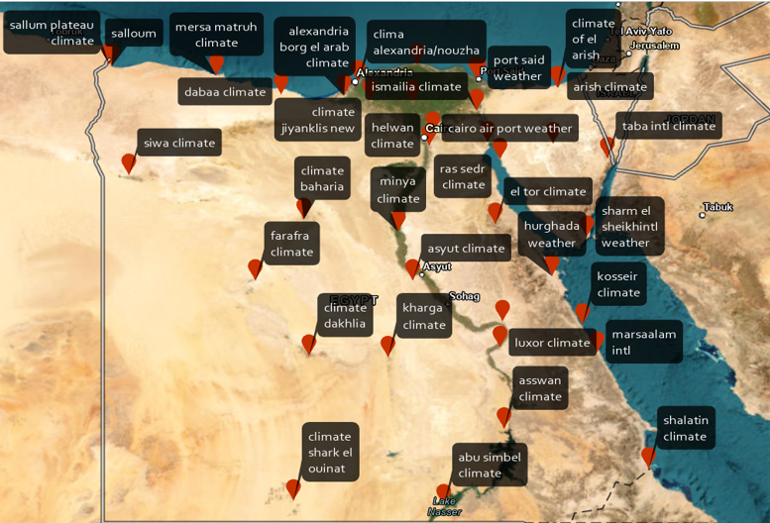
DATA COLLECTION

Slide 9

DATA COLLECTION
COLLECTING TEMPERATURE DATA
Monthly average maximum and minimum temperatures for meteorological stations covering the period from January 1984 to 2024 were obtained from the NASA POWER website

Slide 10
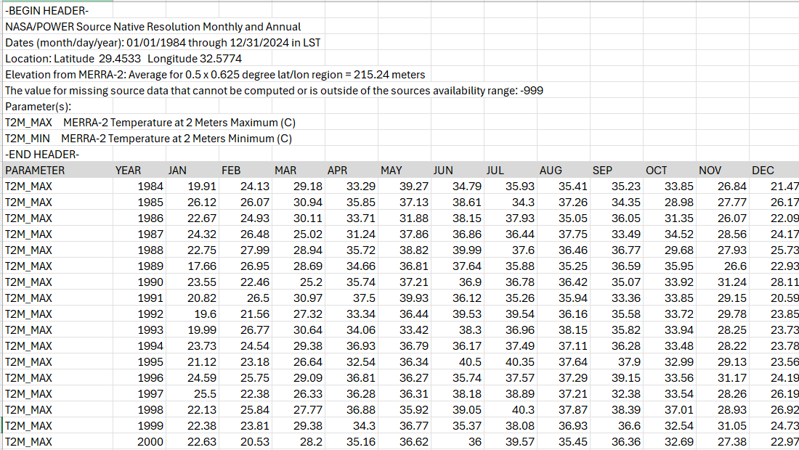
DATA COLLECTION

Slide 11
DATA COLLECTION
name | code | latitude | longitude | Summer_mean_1984_1993 | Summer_mean_1994_2003 | Summer_mean_2004_2013 | Summer_mean_2014_2024
abu simbel climate | 624190 | 22.36 | 31.61 | 40.65 | 40.96 | 41.14 | 41.83
clima alexandria/nouzha | 623180 | 31.2 | 29.95 | 39.85 | 40.31 | 40.39 | 41.1
alexandria borg el arab climate | 623601 | 30.91 | 29.68 | 40.01 | 40.56 | 40.69 | 41.43
asswan climate | 624140 | 23.96 | 32.78 | 40.33 | 40.89 | 41.01 | 41.84
asyut climate | 623930 | 27.05 | 31.01 | 41.08 | 41.71 | 41.78 | 42.62
climate baharia | 624200 | 28.33 | 28.9 | 41.41 | 42.06 | 42.13 | 42.96
baltimate weather | 623250 | 31.55 | 31.1 | 41.75 | 42.46 | 42.57 | 43.33
cairo air port weather | 623660 | 30.13 | 31.4 | 42.33 | 43.07 | 43.18 | 43.93
dabaa climate | 623090 | 30.93 | 28.46 | 42.49 | 43.25 | 43.36 | 44.12
climate dakhlia | 624320 | 25.48 | 29 | 42.42 | 43.21 | 43.23 | 44.02
climate of el arish | 623360 | 31.08 | 33.81 | 42.74 | 43.65 | 43.56 | 44.33
arish climate | 623370 | 31.08 | 33.83 | 42.94 | 43.94 | 43.85 | 44.51
el tor climate | 624590 | 28.23 | 32.61 | 43.12 | 43.98 | 43.98 | 44.48
el-suze climate | 624500 | 29.93 | 32.46 | 44.34 | 45.14 | 45.36 | 45.69
farafra climate | 624230 | 27.05 | 27.96 | 44.74 | 45.3 | 45.75 | 46.08
ghazza climate | 623380 | 31.5 | 34.45 | 44.75 | 45.34 | 45.93 | 46.21
helwan climate | 623780 | 29.86 | 31.33 | 43.28 | 43.94 | 44.26 | 44.6
hurghada weather | 624630 | 27.15 | 33.71 | 43.11 | 43.72 | 43.74 | 44.21
ismailia climate | 624400 | 30.6 | 32.25 | 42.89 | 43.55 | 43.4 | 44.05
climate jiyanklis new | 624620 | 30.81 | 30.18 | 38.37 | 39.32 | 38.91 | 39.88
kharga climate | 624350 | 25.45 | 30.53 | 31.5 | 32.29 | 32.32 | 32.77
kosseir climate | 624650 | 26.13 | 34.3 | 31.49 | 32.18 | 32.22 | 32.44
luxor climate | 624050 | 25.66 | 32.7 | 40.03 | 40.28 | 40.5 | 41.16
marsaalam intl | 623661 | 25.55 | 34.58 | 39.21 | 39.53 | 39.65 | 40.38
mersa matruh climate | 623060 | 31.33 | 27.21 | 39.6 | 40.16 | 40.19 | 40.95
minya climate | 623870 | 28.08 | 30.73 | 40.41 | 40.97 | 41.05 | 41.9
nehkel climate | 624520 | 29.91 | 33.73 | 41.12 | 41.69 | 41.71 | 42.62

Slide 12

Methodology
DISTRIBUTION OF TEMPERATURES ACROSS EGYPT'S GOVERNORATES OVER DIFFERENT DECADES

Slide 13
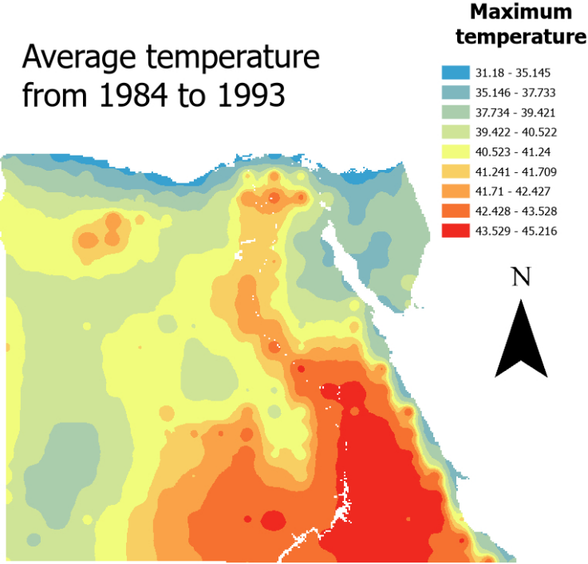

Slide 14
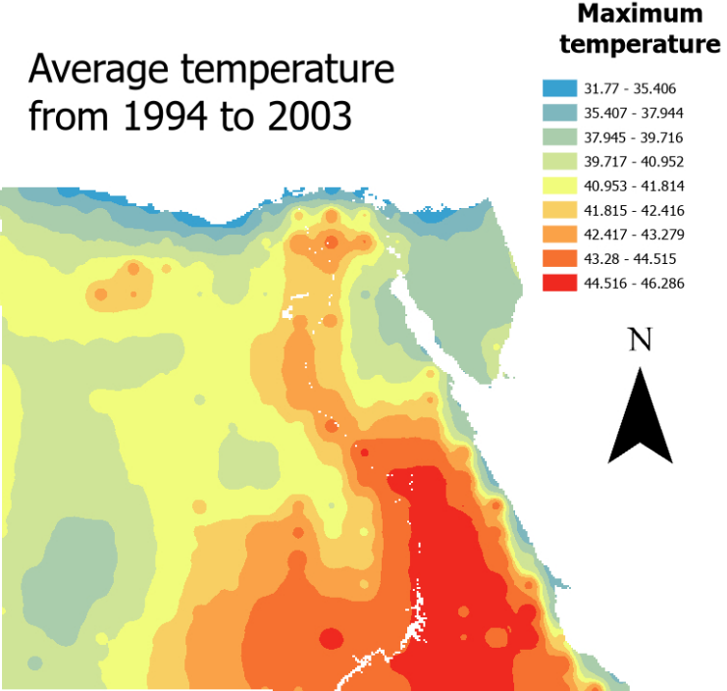

Slide 15
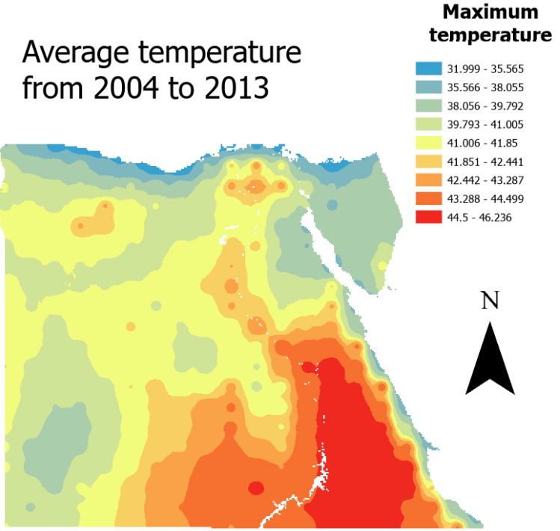

Slide 16
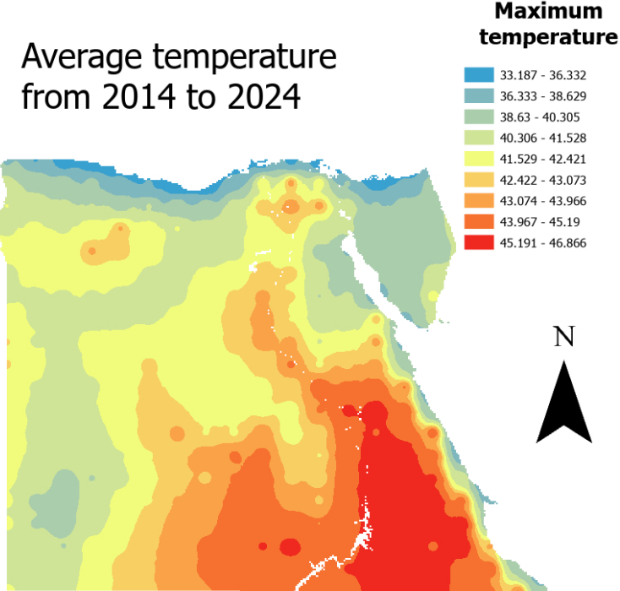

Slide 17
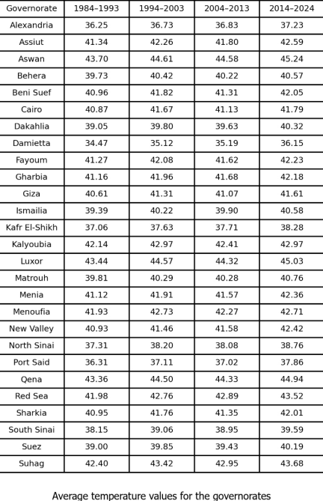

Slide 18
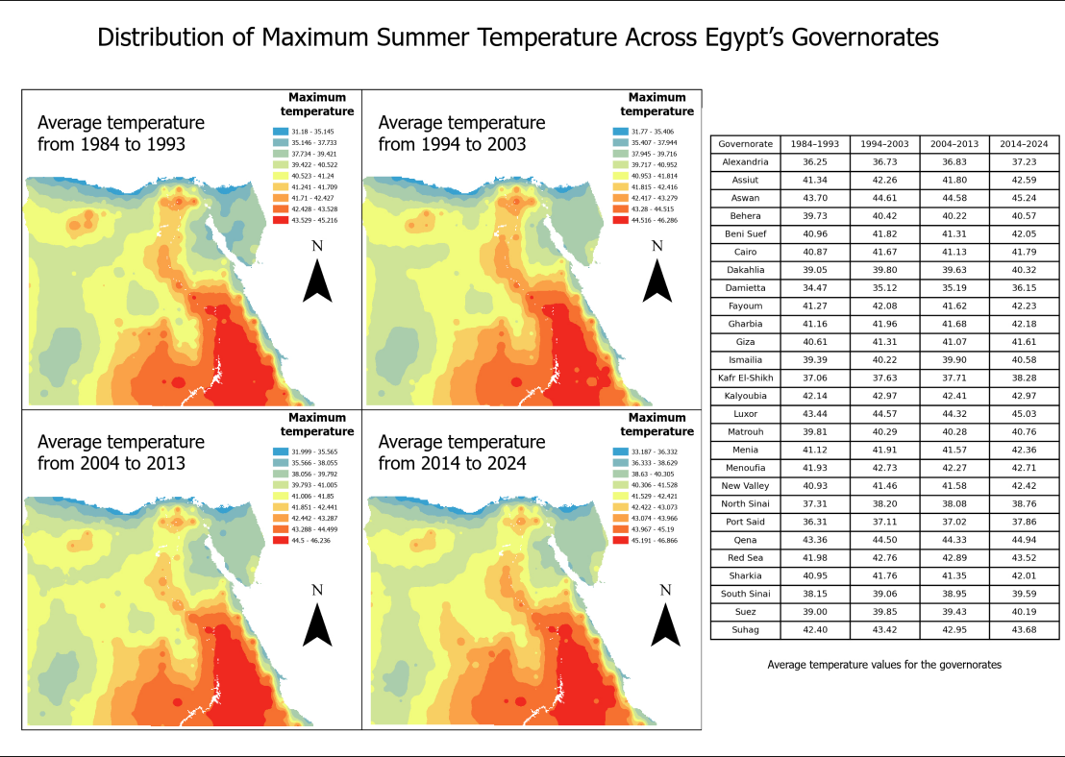

Slide 19
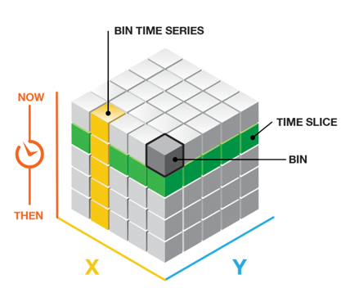
Time series analysis
Trend analysis
mann kendall test
sen's slope
space-time cube
S-static
Z-score
P-value

Slide 20
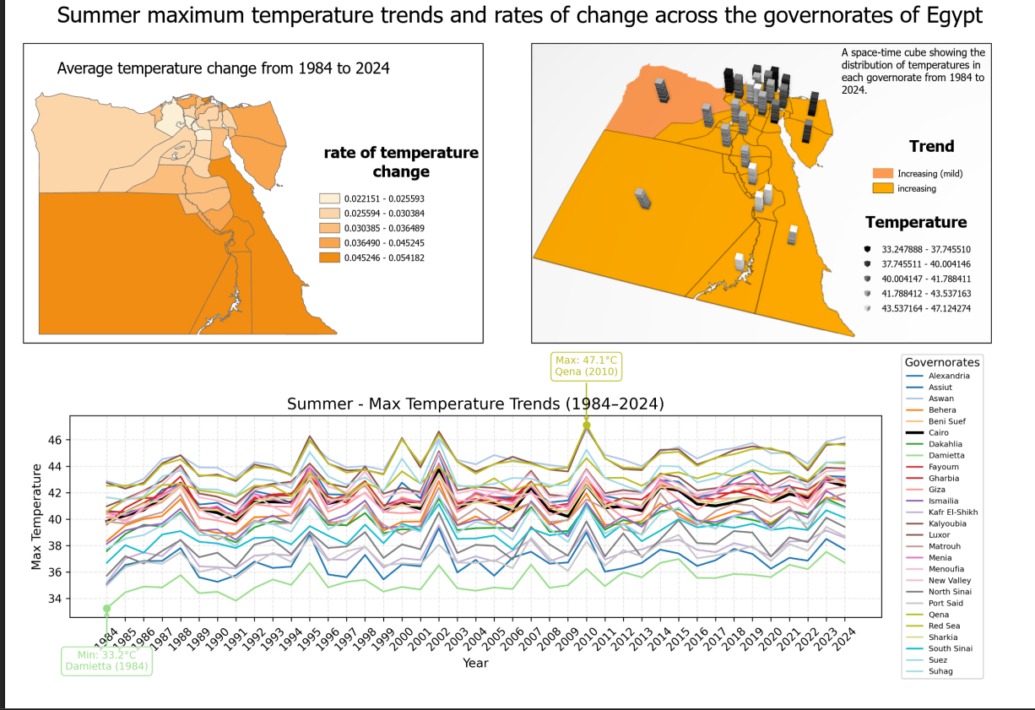

Slide 21
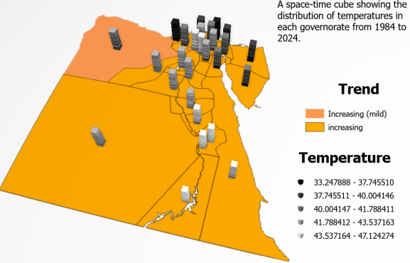

Slide 22
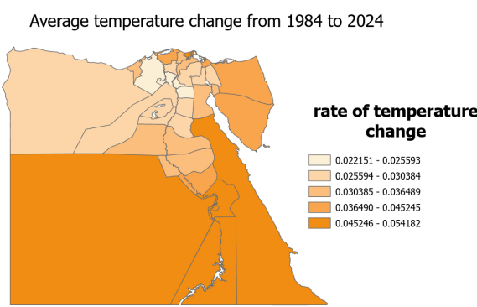

Slide 23
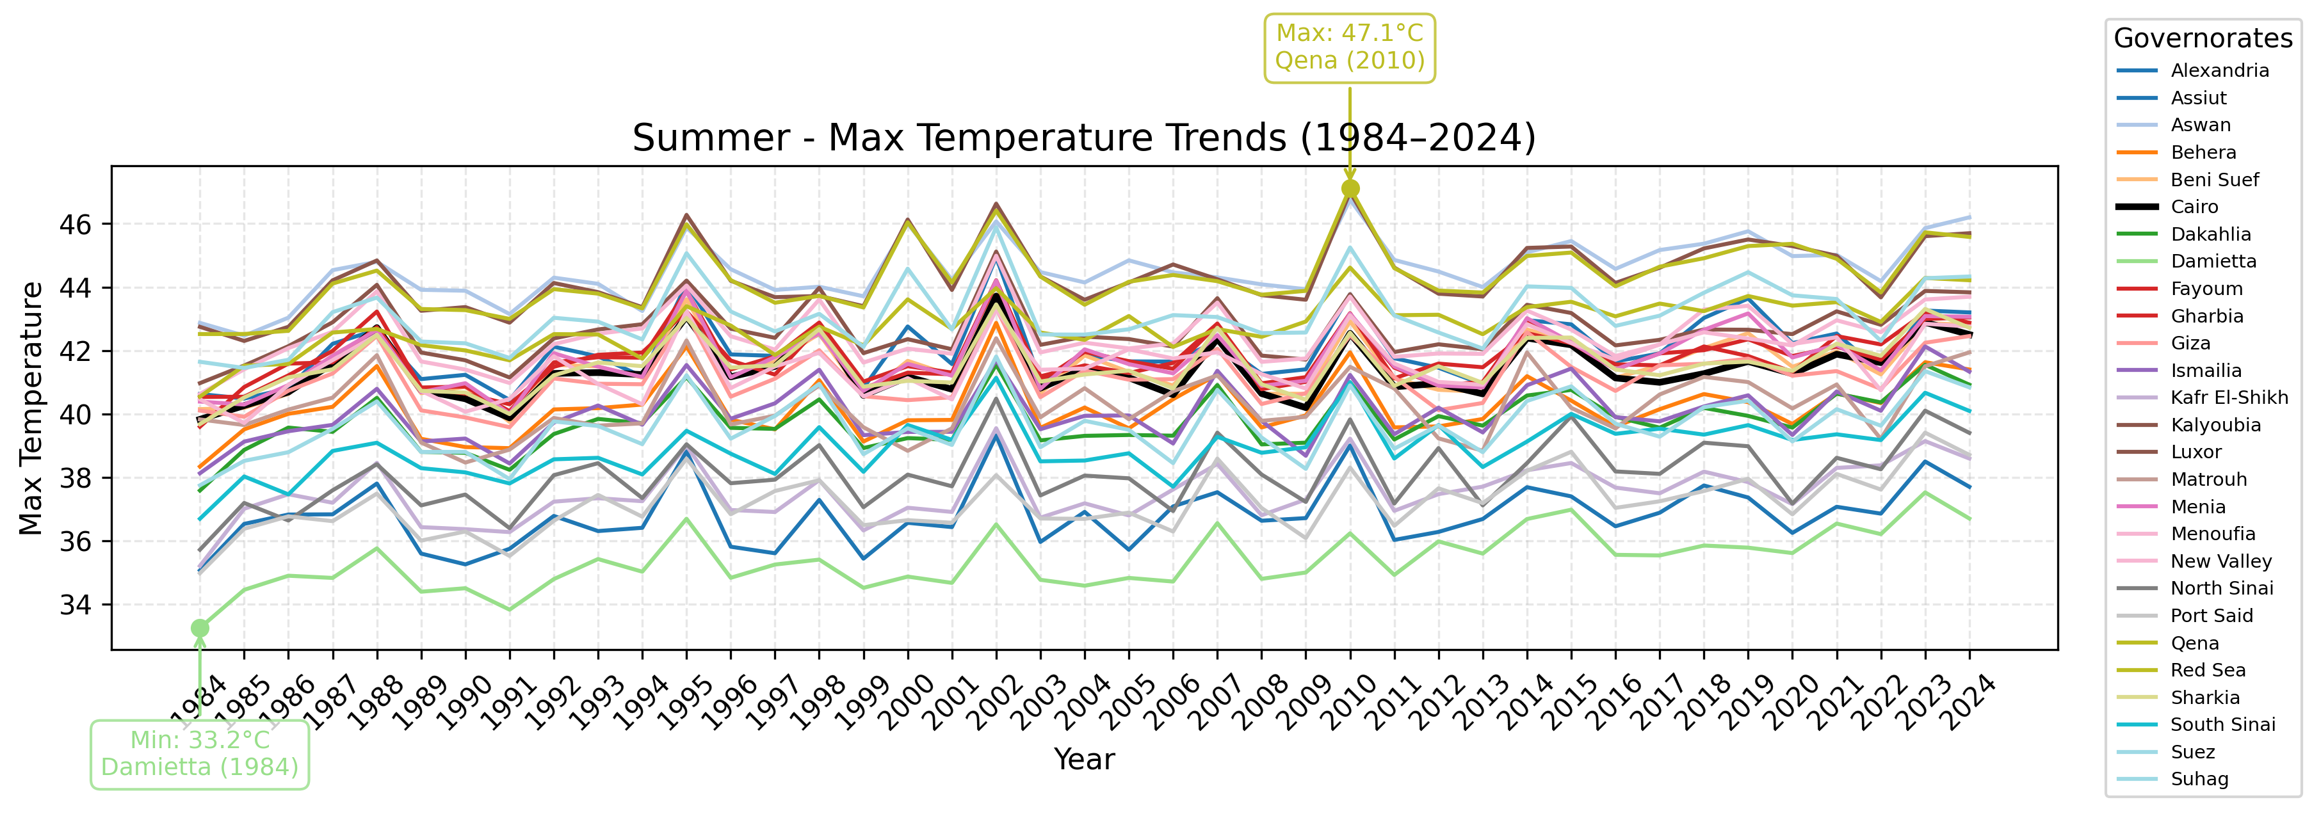

Slide 24
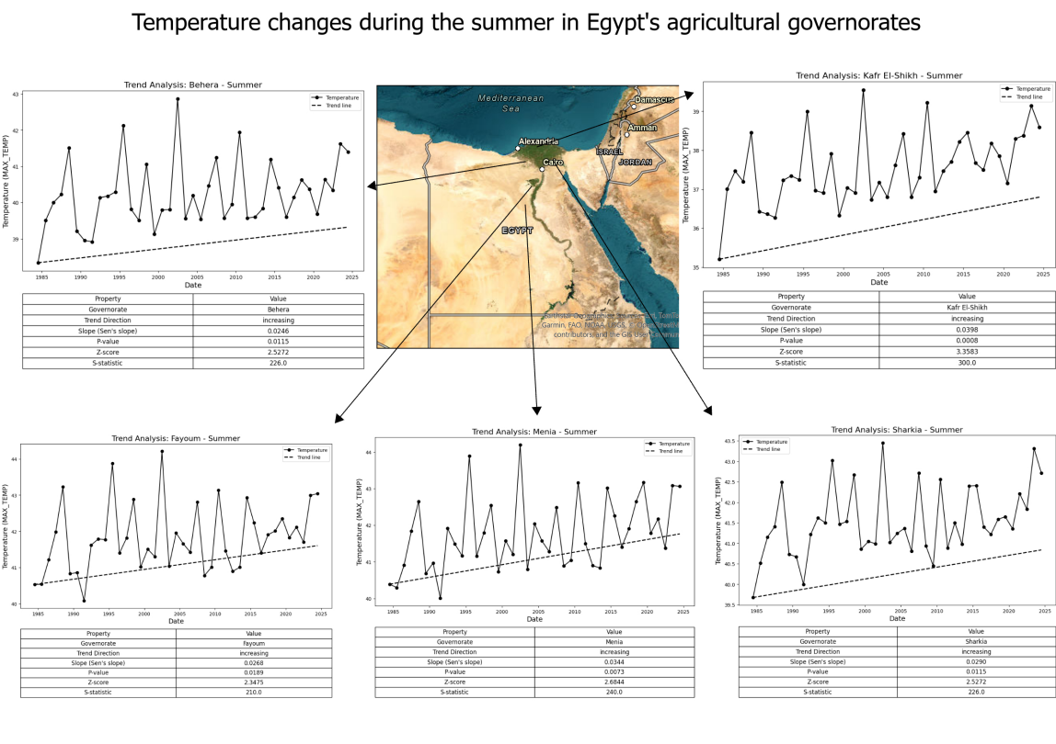

Slide 25
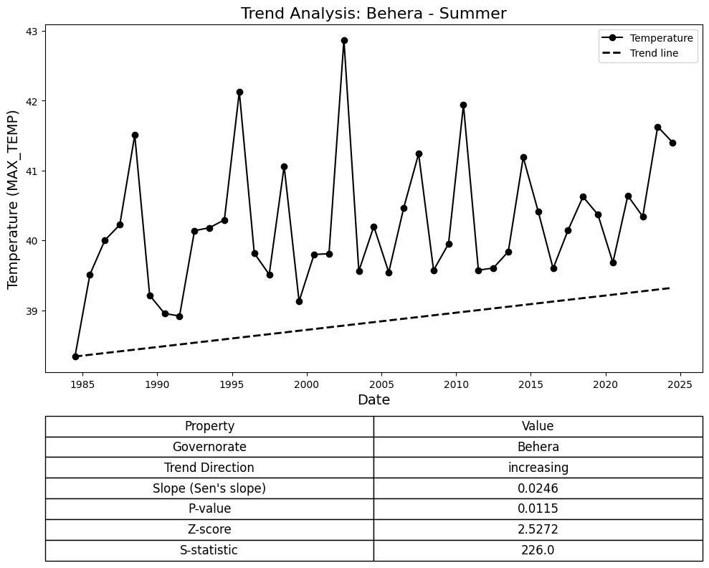

Slide 26
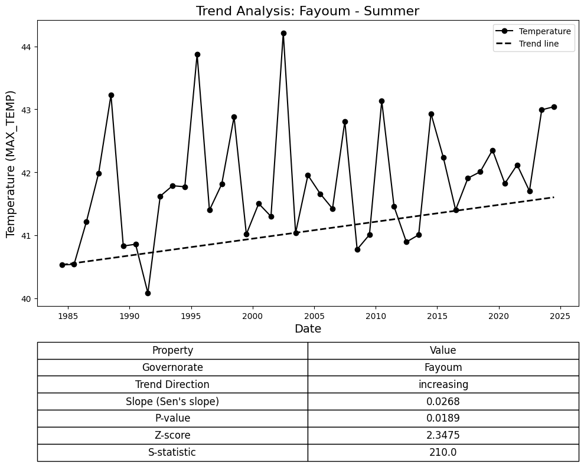

Slide 27
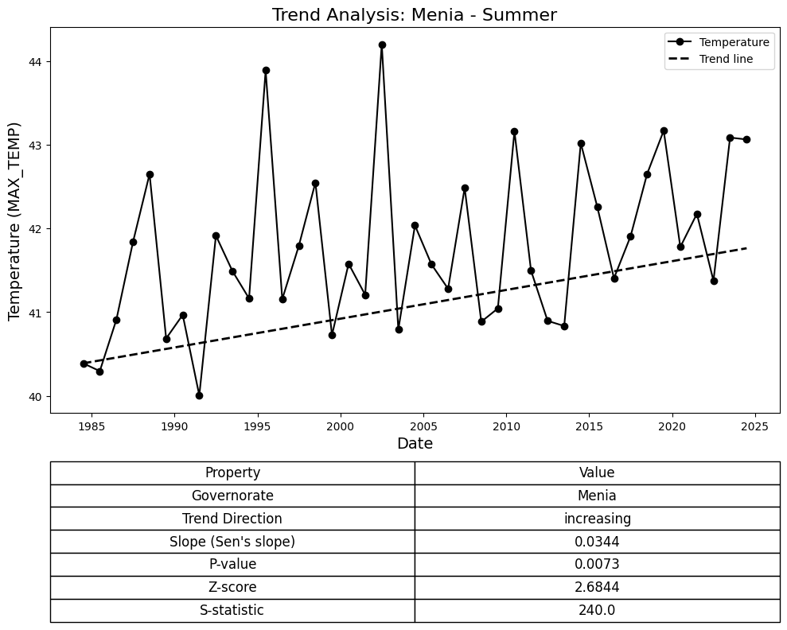

Slide 28
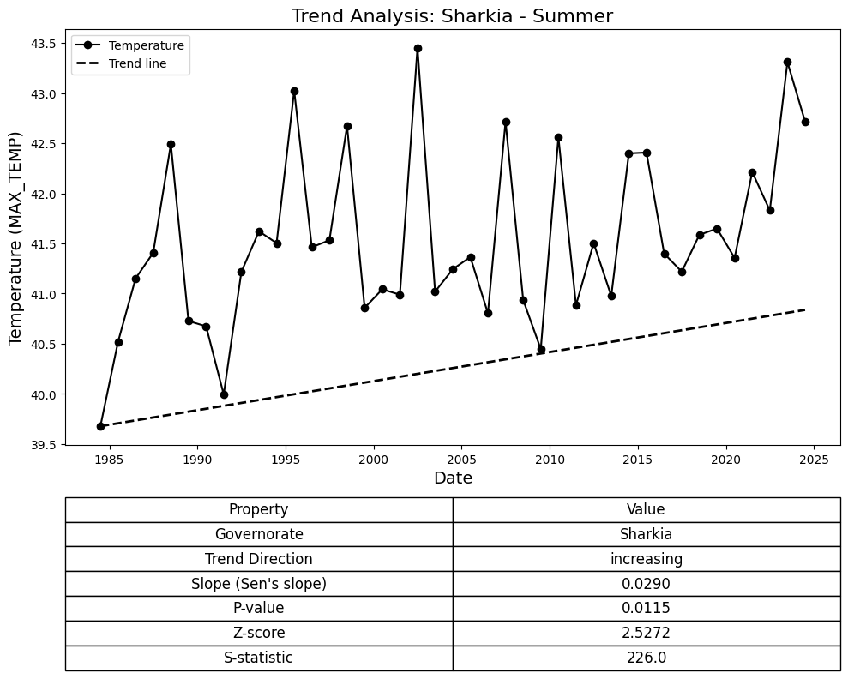

Slide 29
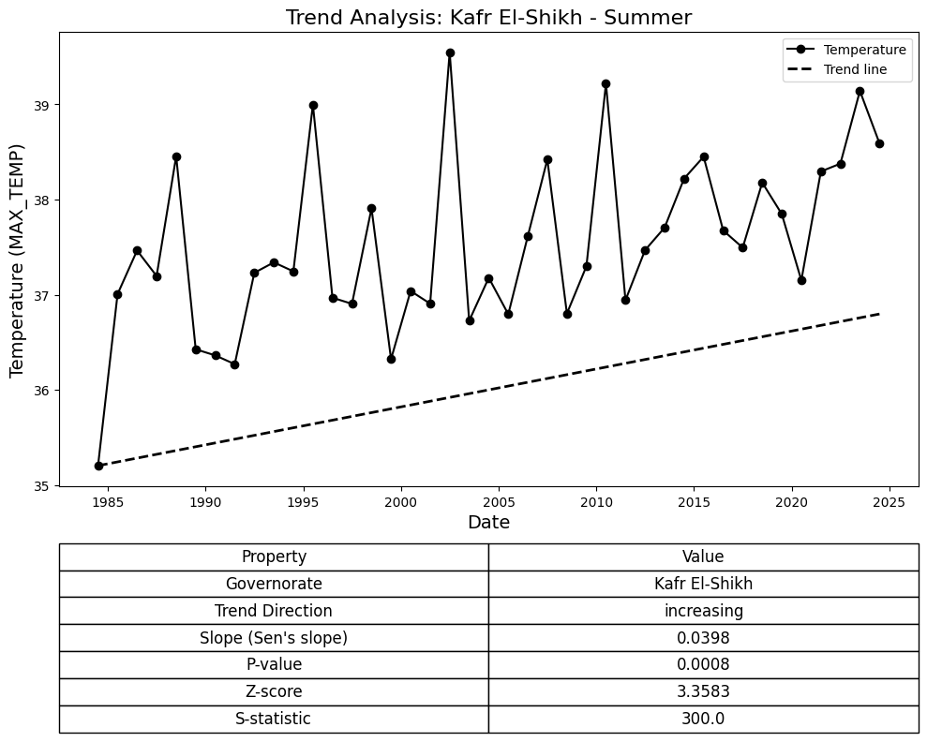

Slide 30
Thank you

